Slide 1
Calendar App
By: Andrew Sverdrup, Kolten Leffler, Nick DiPinto, Robert Velarde

Slide 2
Use Case
Notes:
Andrew
Use Case – level 0

Slide 3
Capability Requirements
The application shall display dates in a monthly format.
The application shall display an event list for a date upon user request.
The application shall display event information for an event upon user request.
Event information shall consist of an event title, start time (time and date), end time (time and date), and any additional notes about the event
Notes:
Nick

Slide 4
Capability Requirements cont.
The application shall send reminders to users concerning upcoming events using the following mediums:
email
SMS text message
OS notification
The application shall add, remove, or edit an event upon user request.
The application shall display all events in a category upon user request.
The application shall export calendars and events to a .ics file upon user request.
The application shall allow users to import events from Facebook to the calendar.
Notes:
Nick

Slide 5
Capability Requirements cont.
The application shall import .ics files containing event information to the calendar upon user request.
The application shall display the date, time, and title for each reminder scheduled within the next 7 days on the applications home screen.
The application shall display the title and start time for each event scheduled for the current day inside the applications home screen.
The application home screen shall highlight the current day inside the calendar.
The application home screen shall allow users to change the current month displayed on the home screen.
Notes:
Nick

Slide 6
System Requirements
The application shall run on the following operating systems.
Windows 7/10
Mac OS X
Linux
The system needs at least 1 GB of RAM.
The system needs a CPU of i3 or better.
Notes:
Nick

Slide 7
Performance Requirements
The application shall import and export .ics files not exceeding a size of 10 MB¹.
The application shall use no more than 200 MB of RAM².
The size of the application shall not exceed 100 MB of storage³.
Footnotes:
Value found from research that was readily available from www.answers.microsoft.com
Value found from research that was readily available from www.stackoverflow.com
Value found from comparing to application size of Calendar application on Mac laptop
Notes:
Nick

Slide 8
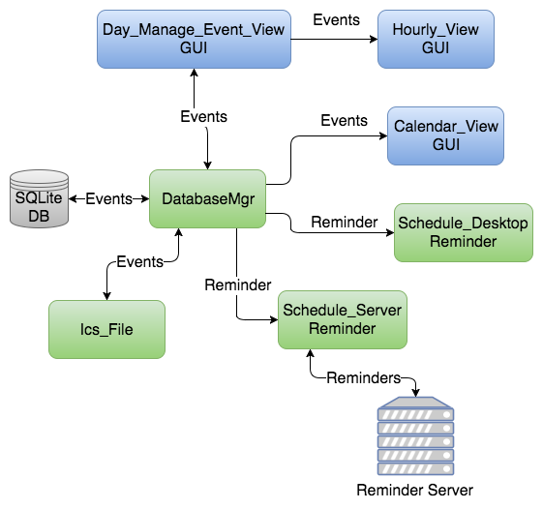
Block Diagram
Notes:
Robert
Block Diagram – Level 0

Slide 9
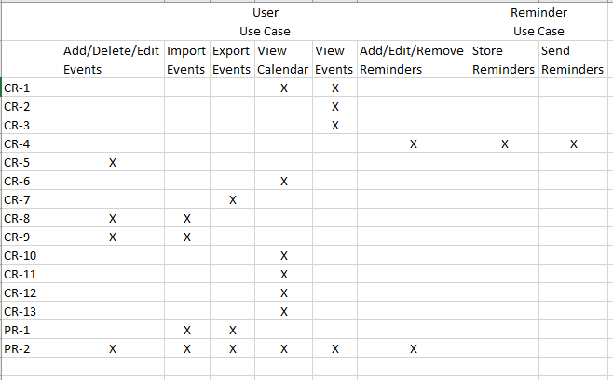
Use Case to Req. Tracing
Notes:
Andrew

Slide 10
Class Diagram
Notes:
Andrew
Class Diagram- Level 1

Slide 11
Add Event ISD – Level 2
Notes:
Robert

Slide 12
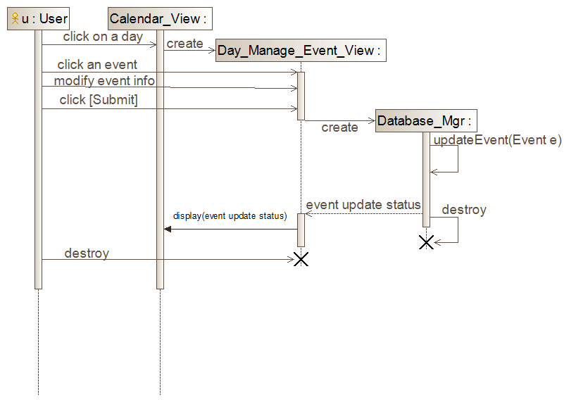
Modify Event ISD – Level 2
Notes:
Robert

Slide 13
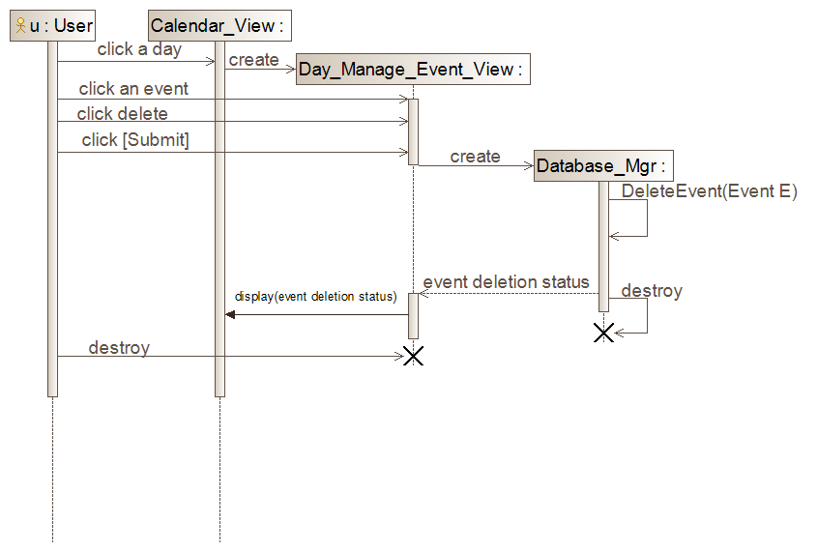
Delete Event ISD – Level 2
Notes:
Robert

Slide 14
Notes:
Kolten
State machine diagram – level 3

Slide 15
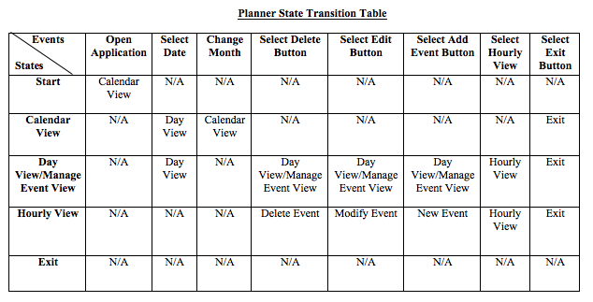
Notes:
Kolten

Slide 16
Notes:
Kolten
Add Event Activity Diagram – Level 3

Slide 17
Notes:
Kolten

Slide 18
Notes:
Kolten

Slide 19
Prototype
Notes:
Andrew

Slide 20
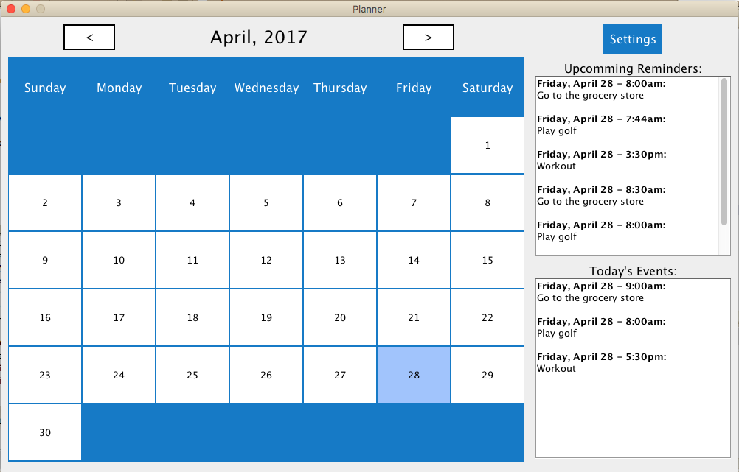
Notes:
Andrew

Slide 21
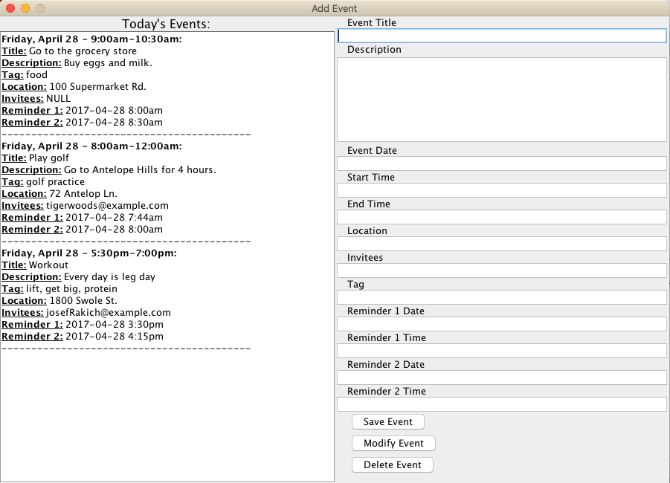
Notes:
Andrew

Slide 22
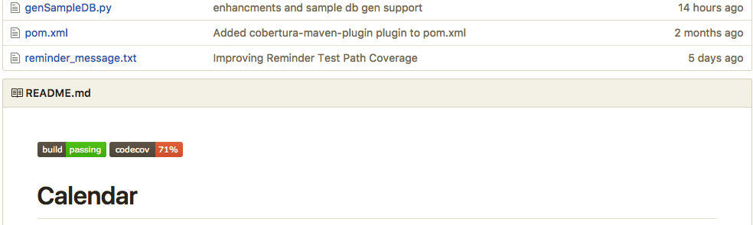
Testing

Slide 23
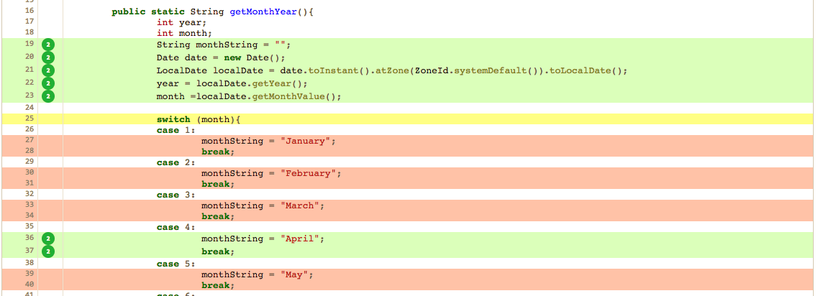
codecov.io

Slide 24
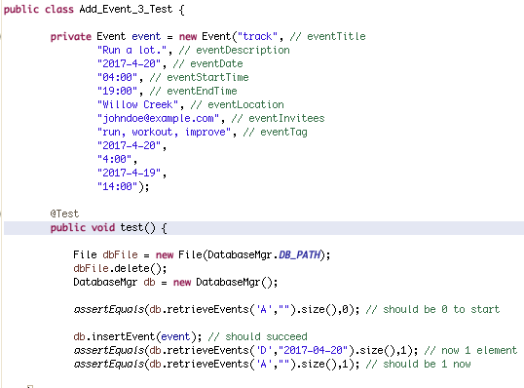
Add Event JUnit Test

Slide 25
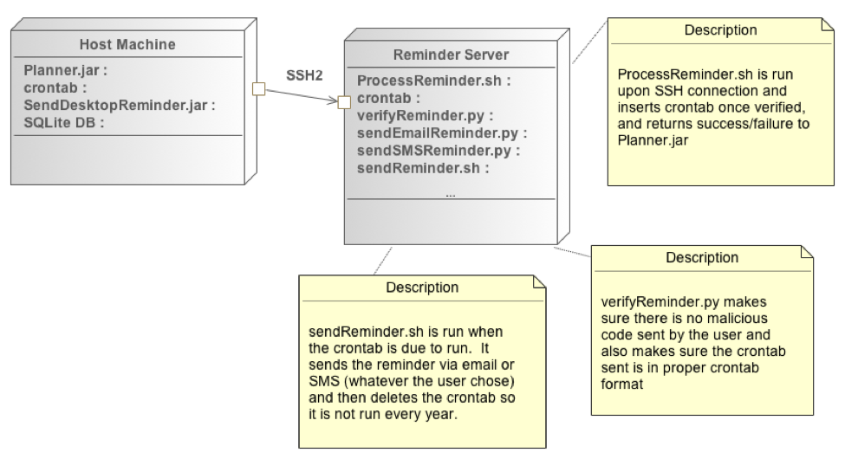
Deployment Diagram
Notes:
Andrew

